Slide 1
Chongqing University of Technology
ATAI
Advanced Technique of Artificial Intelligence
Chongqing University of Technology
Code:None
MDNN: A Multimodal Deep Neural Network for Predicting
Drug-Drug Interaction Events
Tengfei Lyu1, Jianliang Gao1, Ling Tian1, Zhao Li2, Peng Zhang3 and Ji Zhang4
1School of Computer Science and Engineering, Central South University
2Alibaba Group, Hangzhou, China
3Cyberspace Institute of Advanced Technology, Guangzhou University
4Zhejiang Lab, Hangzhou, China
ftengfeilyu, gaojianliang, tianlingg@csu.edu.cn, lizhao.lz@alibaba-inc.com,
zhangpeng04@gmail.com, zhangji77@gmail.com
Code : None
IJCAI_2021
Reported by Xinsheng Wang

Slide 2
Chongqing University of Technology
ATAI
Advanced Technique of Artificial Intelligence
Chongqing University of Technology
1.Introduction
2.Method
3.Experiments

Slide 3
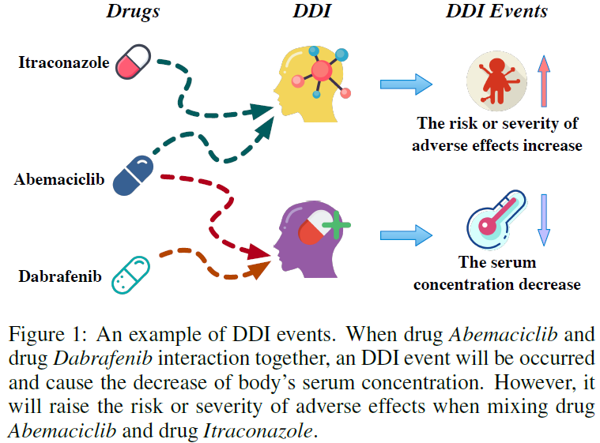
Introduction
血清浓度降低

Slide 4
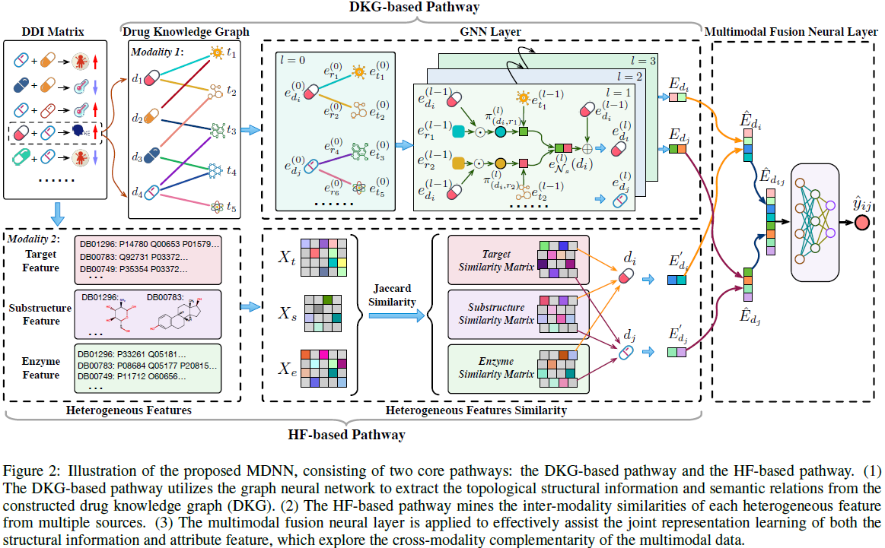
Method
酶特征

Slide 5
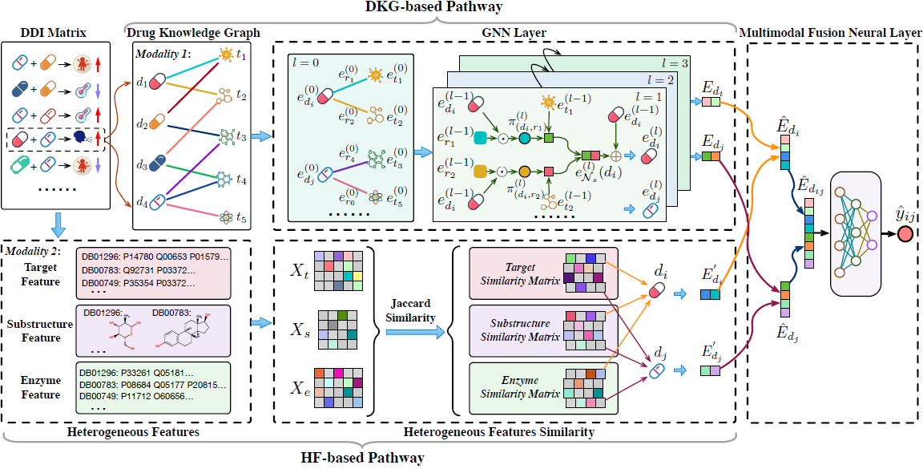
Method
Drug Knowledge Graph
The GNN Layer

Slide 6
Method
The HF-based Pathway
Jaccard similarity
？
Multimodal Neural Fusion Layer

Slide 7
Experiments

Slide 8
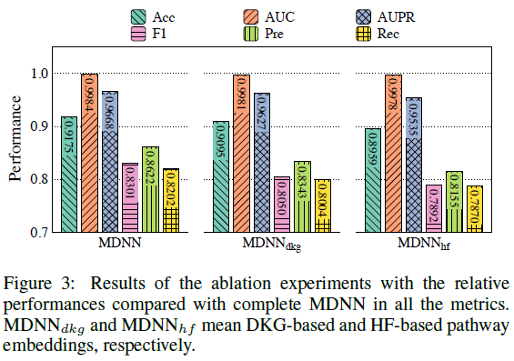
Experiments

Slide 9
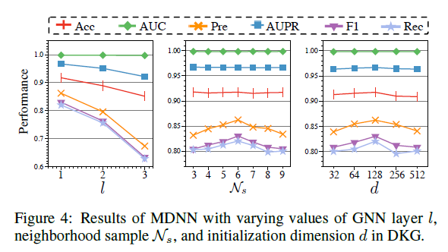
Experiments

Slide 10
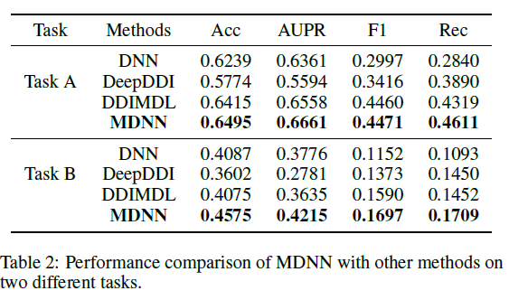
Experiments

Slide 11
Thank you!

